Slide 1
Requirement Modelling Techniques

Slide 2
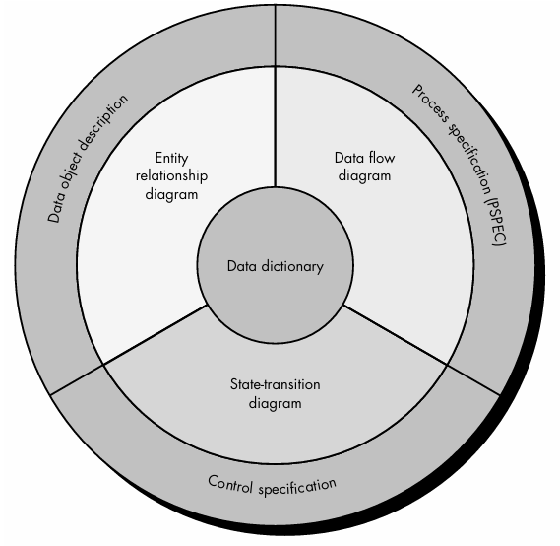

Slide 3
ER Diagram

Slide 4
ER Model
The Entity Relationship Model is a model for identifying entities (like student, car or company) to be represented in the database and representation of how those entities are related.
The ER data model specifies enterprise schema that represents the overall logical structure of a database graphically.

Slide 5
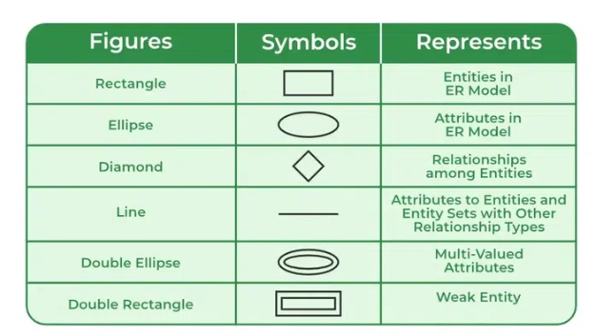
Symbols Used

Slide 6
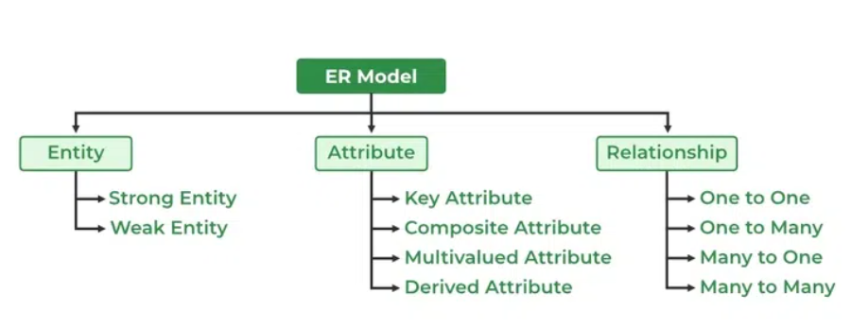
Components of ER Diagram
ER Model consists of Entities, Attributes, and Relationships among Entities in a Database System.

Slide 7
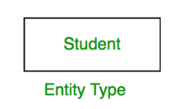
Entity
An Entity may be an object with a physical existence – a particular person, car, house, or employee – or it may be an object with a conceptual existence – a company, a job, or a university course.
Entity Set
An Entity is an object of Entity Type and a set of all entities is called an entity set. For Example, E1 is an entity having Entity Type Student and the set of all students is called Entity Set. In ER diagram, Entity Type is represented as:

Slide 8
Types of Entity
Strong Entity
A Strong Entity is a type of entity that has a key Attribute.
Strong Entity does not depend on other Entity in the Schema.
It has a primary key, that helps in identifying it uniquely,
and it is represented by a rectangle.

Slide 9
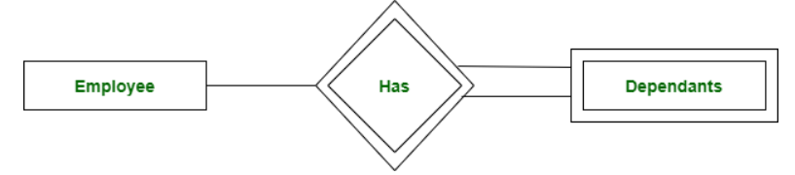
Weak Entity
An Entity type has a key attribute that uniquely identifies each entity in the entity set. But some entity type exists for which key attributes can’t be defined.
For Example, A company may store the information of dependents (Parents, Children, Spouse) of an Employee. But the dependents can’t exist without the employee.
So Dependent will be a Weak Entity Type and Employee will be Identifying Entity type for Dependent, which means it is Strong Entity Type .
A weak entity type is represented by a Double Rectangle.
The participation of weak entity types is always total. The relationship between the weak entity type and its identifying strong entity type is called identifying relationship and it is represented by a double diamond.

Slide 10
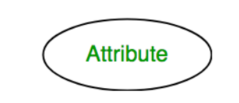
Attributes
Attributes are the properties that define the entity type.
For example, Roll_No, Name, DOB, Age, Address, and Mobile_No are the attributes that define entity type Student. In ER diagram, the attribute is represented by an oval.

Slide 11
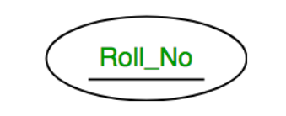
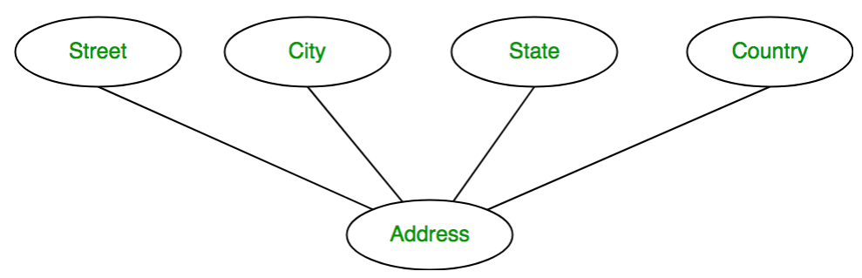
Types of Attributes
1. Key Attribute
The attribute which uniquely identifies each entity in the entity set is called the key attribute. For example, Roll_No will be unique for each student. In ER diagram, the key attribute is represented by an oval with underlying lines.
2. Composite Attribute
An attribute composed of many other attributes is called a composite attribute. For example, the Address attribute of the student Entity type consists of Street, City, State, and Country. In ER diagram, the composite attribute is represented by an oval comprising of ovals.

Slide 12
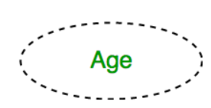
3. Multivalued Attribute
An attribute consisting of more than one value for a given entity. For example, Phone_No (can be more than one for a given student). In ER diagram, a multivalued attribute is represented by a double oval.
4. Derived Attribute
An attribute that can be derived from other attributes of the entity type is known as a derived attribute. e.g.; Age (can be derived from DOB). In ER diagram, the derived attribute is represented by a dashed oval.

Slide 13
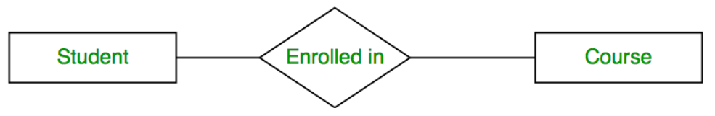
Relationship Type and Relationship Set
A Relationship Type represents the association between entity types. For example, ‘Enrolled in’ is a relationship type that exists between entity type Student and Course. In ER diagram, the relationship type is represented by a diamond and connecting the entities with lines.

Slide 14
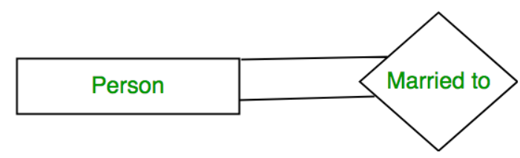
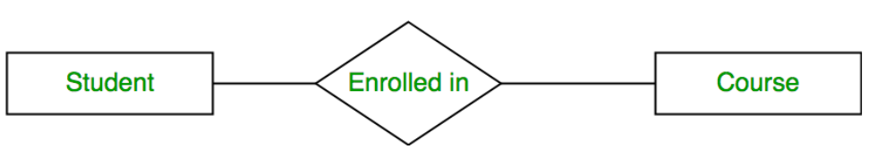
Degree of a Relationship Set
The number of different entity sets participating in a relationship set is called the degree of a relationship set.
1. Unary Relationship: When there is only ONE entity set participating in a relation, the relationship is called a unary relationship. For example, one person is married to only one person.
2. Binary Relationship: When there are TWO entities set participating in a relationship, the relationship is called a binary relationship. For example, a Student is enrolled in a Course.
3. Ternary Relationship: When there are three entity sets participating in a relationship, the relationship is called a ternary relationship.
4. N-ary Relationship: When there are n entities set participating in a relationship, the relationship is called an n-ary relationship.

Slide 15
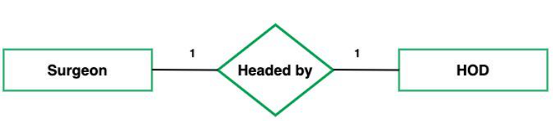
What is Cardinality?
The number of times an entity of an entity set participates in a relationship set is known as cardinality . Cardinality can be of different types:
1. One-to-One: When each entity in each entity set can take part only once in the relationship, the cardinality is one-to-one. The total number of tables that can be used in this is 2.

Slide 16

One-to-Many: In one-to-many mapping as well where each entity can be related to more than one entity and the total number of tables that can be used in this is 2. Let us assume that one surgeon department can accommodate many doctors. So the Cardinality will be 1 to M. It means one department has many Doctors. Total number of tables that can used is 3.

Slide 17
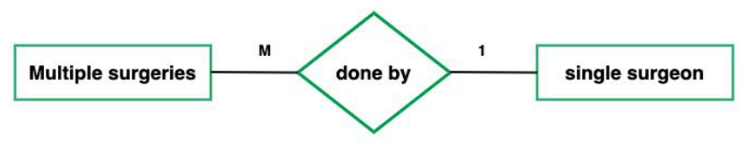
Many-to-One: When entities in one entity set can take part only once in the relationship set and entities in other entity sets can take part more than once in the relationship set, cardinality is many to one. Let us assume that a student can take only one course but one course can be taken by many students. So the cardinality will be n to 1. It means that for one course there can be n students but for one student, there will be only one course.
The total number of tables that can be used in this is 3.

Slide 18
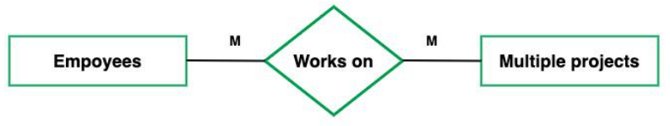
Many-to-Many: When entities in all entity sets can take part more than once in the relationship cardinality is many to many. Let us assume that a student can take more than one course and one course can be taken by many students. So the relationship will be many to many.
the total number of tables that can be used in this is 3.

Slide 19
Functional Modelling
Information is transformed as it flows through a computer-based system.
As information moves through software, it is modified by a series of transformations.
A data flow diagram is a graphical representation that depicts information flow and the transforms that are applied as data move from input to output.
The data flow diagram may be used to represent a system or software at any level of abstraction.
In fact, DFDs may be partitioned into levels that represent increasing information flow and functional detail.

Slide 20
DFD (Functional Modelling)
DFD is the abbreviation for Data Flow Diagram.
The flow of data in a system or process is represented by a Data Flow Diagram (DFD).
It also gives insight into the inputs and outputs of each entity and the process itself.
Data Flow Diagram (DFD) does not have a control flow and no loops or decision rules are present.
Specific operations, depending on the type of data, can be explained by a flowchart.
It is a graphical tool, useful for communicating with users, managers and other personnel.
It is useful for analyzing existing as well as proposed systems.

Slide 21
Data flow diagram provides an overview of
What data is system processes.
What transformation are performed.
What data are stored.
What results are produced , etc.

Slide 22
Key Elements of a DFD
Processes: These are the core activities within the system, ranging from simple tasks like data collection to complex processes such as generating comprehensive reports.
External Entities: These are the sources or destinations of information that interact with the system, including individuals, organizations, computers, or other systems.
Data Stores: Repositories where data is held, representing information that is static and not in motion.
Data Flows: These illustrate the movement of data between external entities, data stores, and processes, mapping the paths data take within the system.

Slide 23
Rules and Guidelines for Creating DFD:
Creating a coherent and intelligible DFD requires adherence to certain rules:
Process Flows: Each process must have at least one outgoing and one ingoing data flow.
Data Store Connectivity: Data stores should have at least one incoming and outgoing data flow.
Entity-Process Link: Entities must be connected to a process by a data flow.
Avoiding Crossings: Data flows cannot cross with each other.
External Entity Access: Data stores cannot directly connect to external entities.

Slide 24
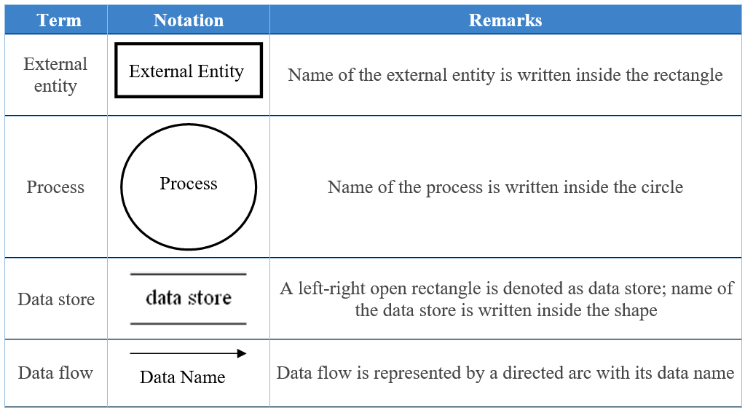

Slide 25
Data flow diagrams are also categorized by level.
Starting with the most basic, level 0,
DFDs get increasingly complex as the level increases.
As you build your own data flow diagram, you will need to decide which level your diagram will be.

Slide 26
Level 0 DFD
Level 0 DFDs, also known as context diagrams, are the most basic data flow diagrams.
They provide a broad view that is easily digestible but offers little detail.
Level 0 data flow diagrams show a single process node and its connections to external entities.

Slide 27
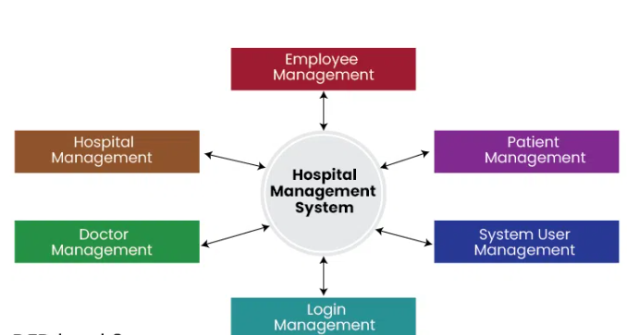

Slide 28
Level 1 DFD
Level 1 DFDs are still a general overview, but they go into more detail than a context diagram.
In level 1 DFD, the single process node from the context diagram is broken down into sub-processes.
As these processes are added, the diagram will need additional data flows and data stores to link them together.

Slide 29
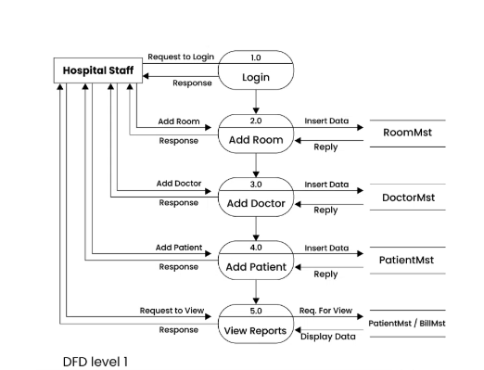
DFD Level 1

Slide 30
DFD Level 2
2-Level provides an even more detailed view of the system by breaking down the sub-processes identified in the level 1 Data Flow Diagram (DFD) into further sub-processes.
Each sub-process is depicted as a separate process on the level 2 DFD.
The data flows and data stores associated with each sub-process are also shown.
2-Level Data Flow Diagram (DFD) goes one step deeper into parts of 1-level DFD.
It can be used to plan or record the specific/necessary detail about the system’s functioning.

Slide 31
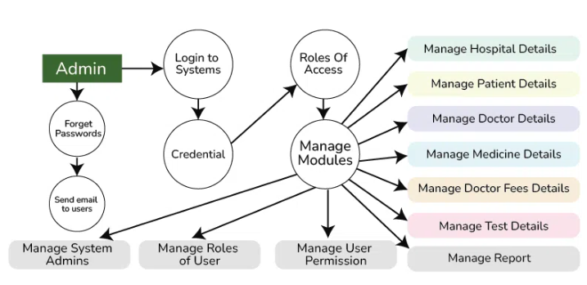
DFD Level 2

Slide 32
State Transition Diagram (Behavioral Modelling)
State Transition Diagram are also known as Dynamic models.
It is a type of diagram that is used to represent different transition (changing) states of a System.
It is generally used to graphically represent all possible transition states a system can have and model such systems.
It is very essential and important and right for object-oriented modeling from the beginning.
The System consists of various states that are being represented using various symbols in the state transition diagram.

Slide 33
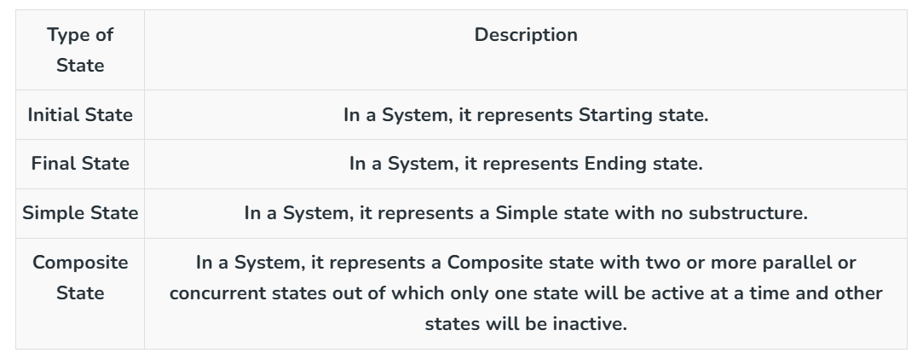

Slide 34
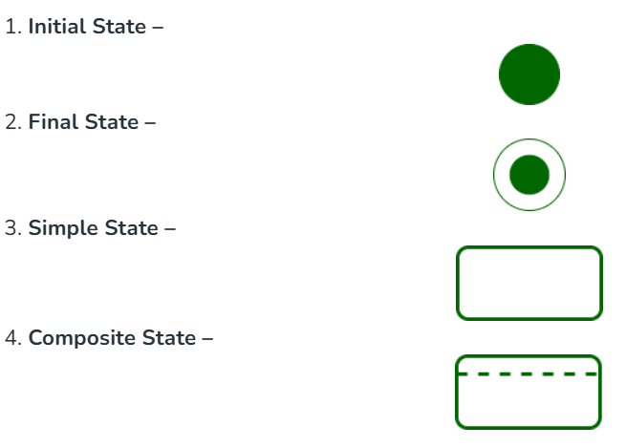
Symbols Used

Slide 35
